Slide 1
Unit-1
Propositions

Slide 2
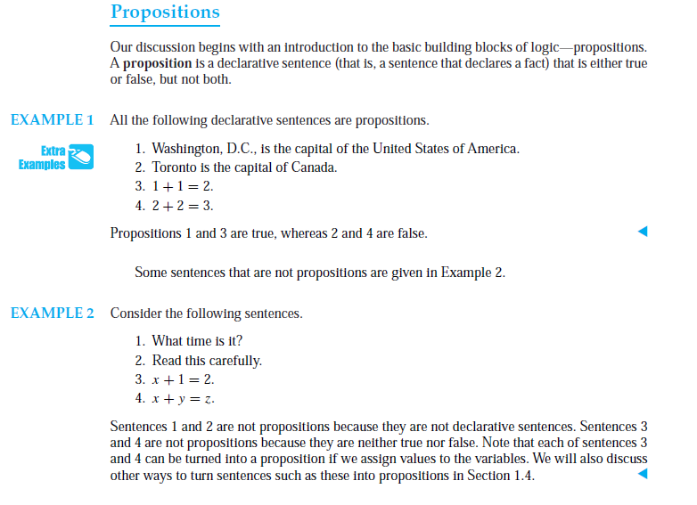

Slide 3
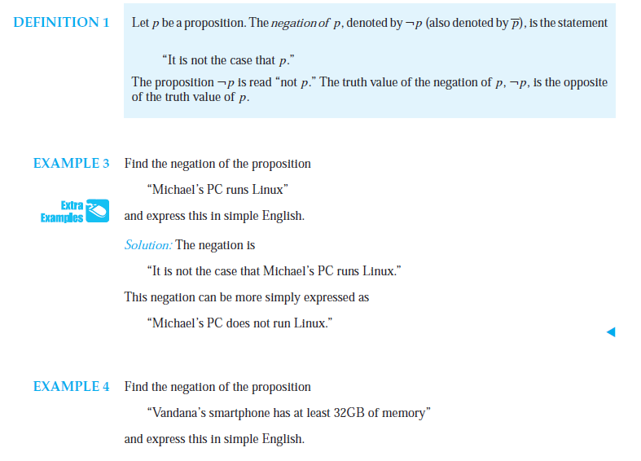

Slide 4
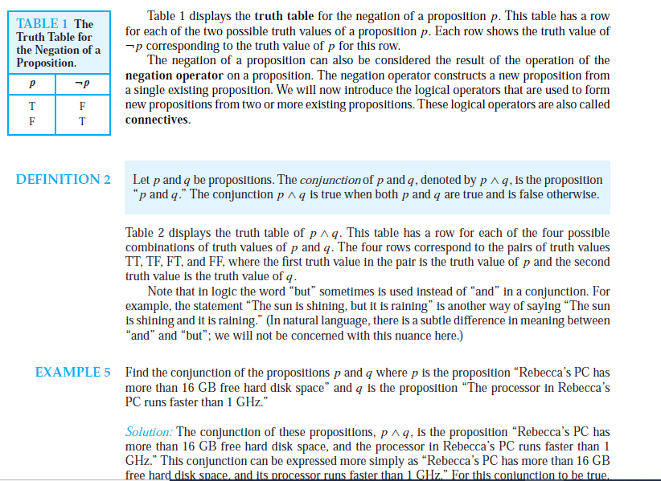

Slide 5
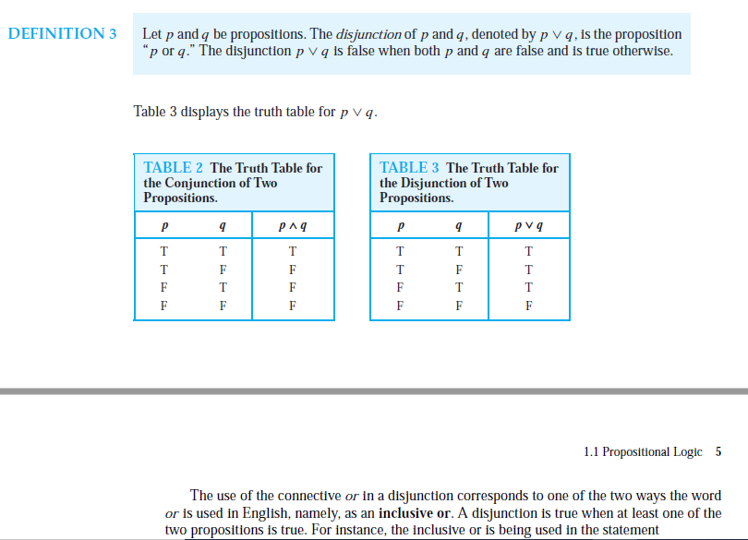

Slide 6
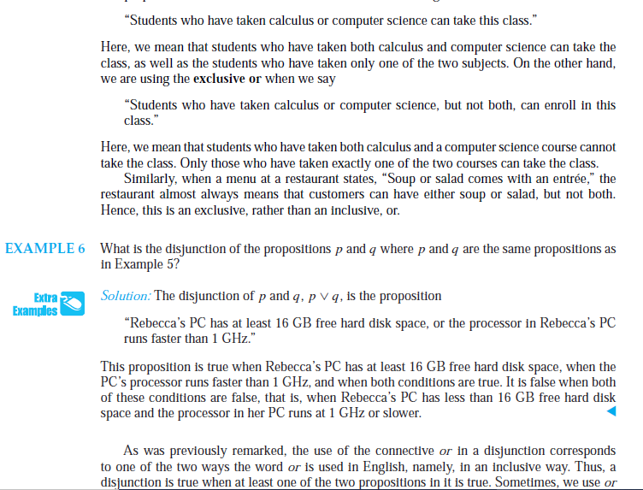

Slide 7
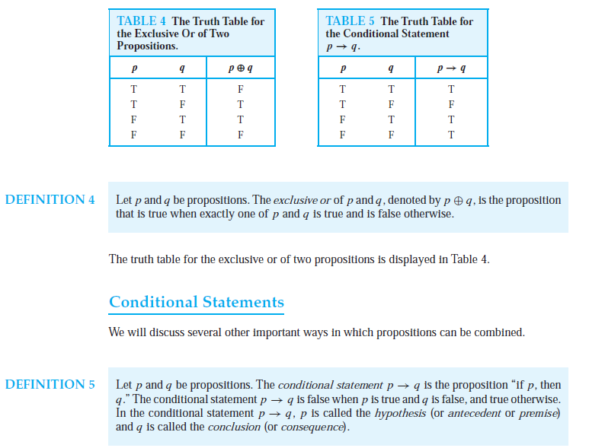

Slide 8
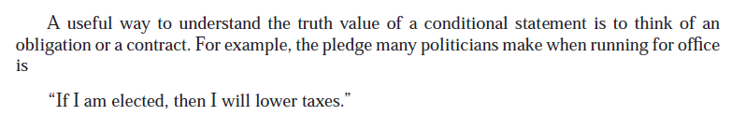
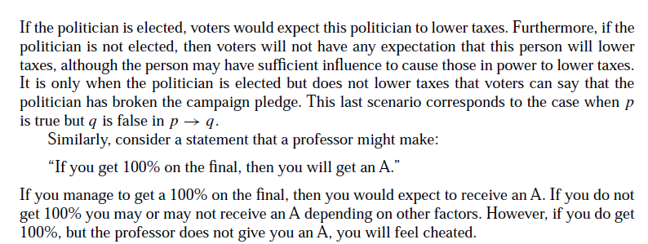

Slide 9
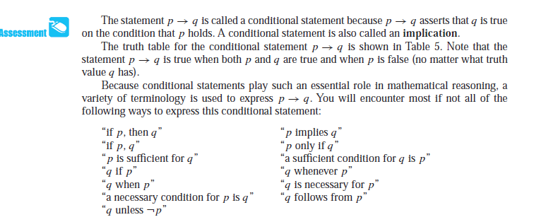

Slide 10
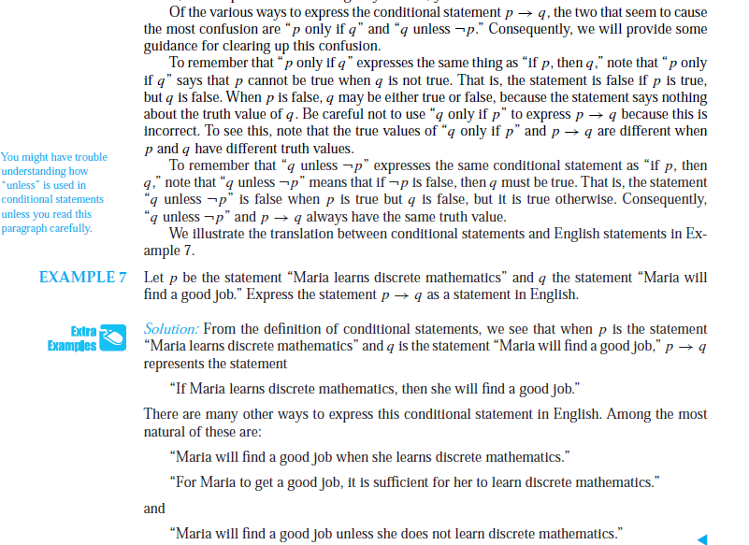

Slide 11
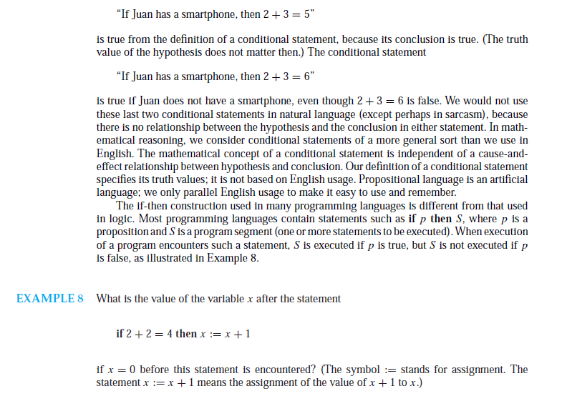

Slide 12
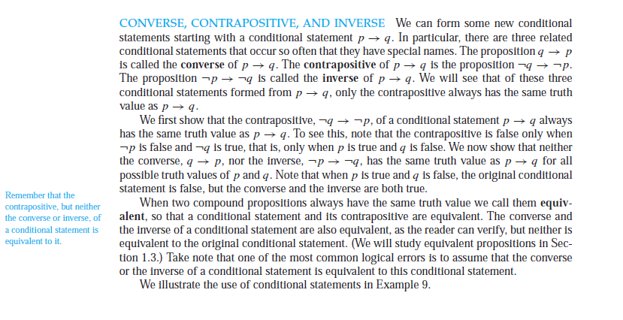

Slide 13
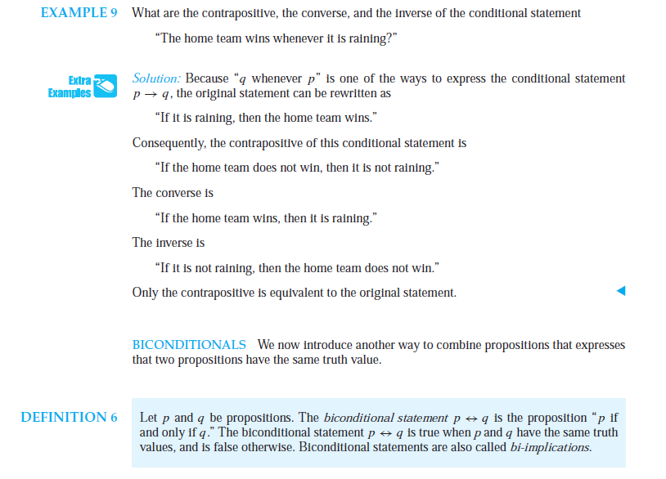

Slide 14
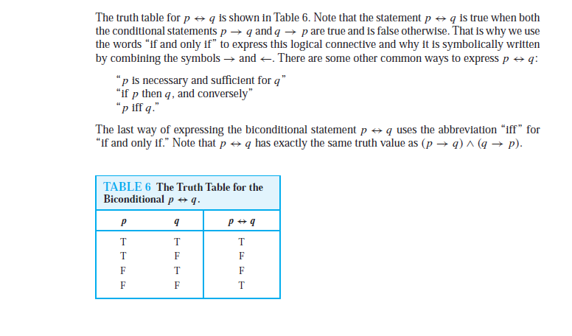

Slide 15
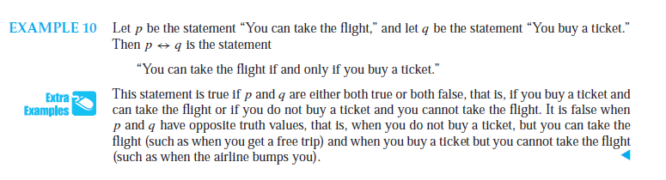

Slide 16
Q.1 If Ramesh wins the lottery then 3+2=5?
(a) True (b) False (c) Not a proposition.
Q.2 If Ramesh wins the lottery then 3+2=6?
(a) True (b) False (c) Not a proposition.
Q.3 If Delhi is the capital of India then 3+2=5?
(a) True (b) False (c) Not a proposition.
Q.4 If Delhi is the capital of India then 3+2=6?
(a) True (b) False (c) Not a proposition.

